Slide 1




Emerging Non-Volatile Memory: Resistive Switching Behaviors in Amorphous Tungsten Oxide Dielectric
Maxwell Weiss
Supervisor: Dr. Ying-Chen Chen
Northern Arizona University
Department of Electrical Engineering
NASA Space Grant Symposium

Slide 2
Outline
Motivation
Experimental Methods
Results and Discussion
Conclusion and future work

Slide 3
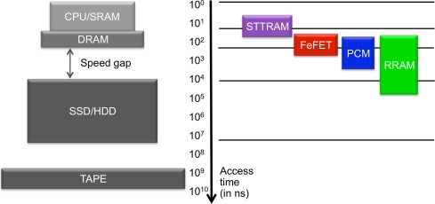
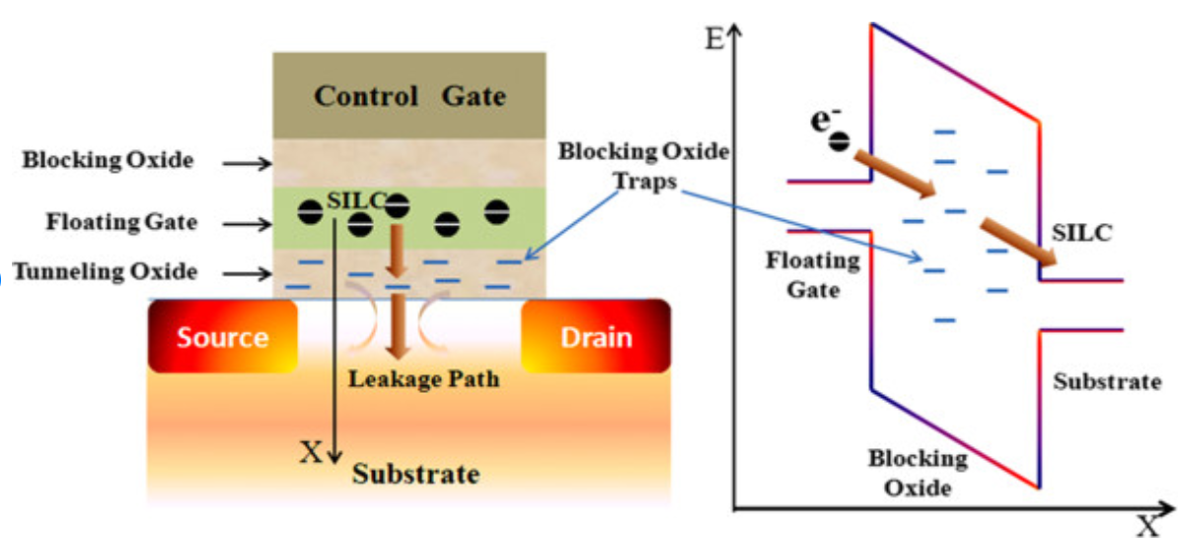
Motivation
Source: An Chen, A review of emerging non-volatile memory (NVM) technologies and applications, Solid-State, Electronics, Volume 125, 2016.
Meena, Jagan & Sze, Simon & Chand, Umesh & Tseng, Tseung-Yuen. (2014). Overview of Emerging Non-volatile Memory Technologies. Nanoscale Research Letters. 9. 1-33.
There exists a speed gap between fast, volatile memories (i.e. DRAM,SRAM) and slow, non-volatile memory (i.e. Flash).
Transistor based Flash memory cannot scale down to smaller feature sizes due to increasing charge loss (i.e data loss).
We want to find the next generation memory to improve upon Flash speed, reliability, and scalability

Slide 4
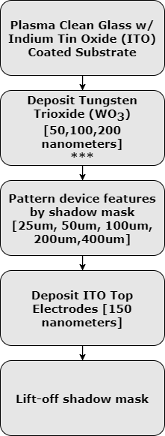
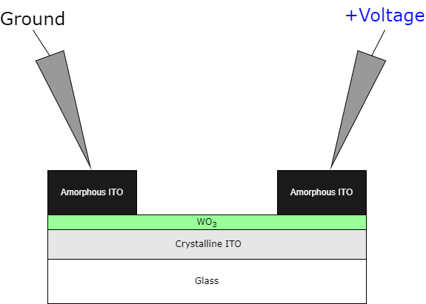
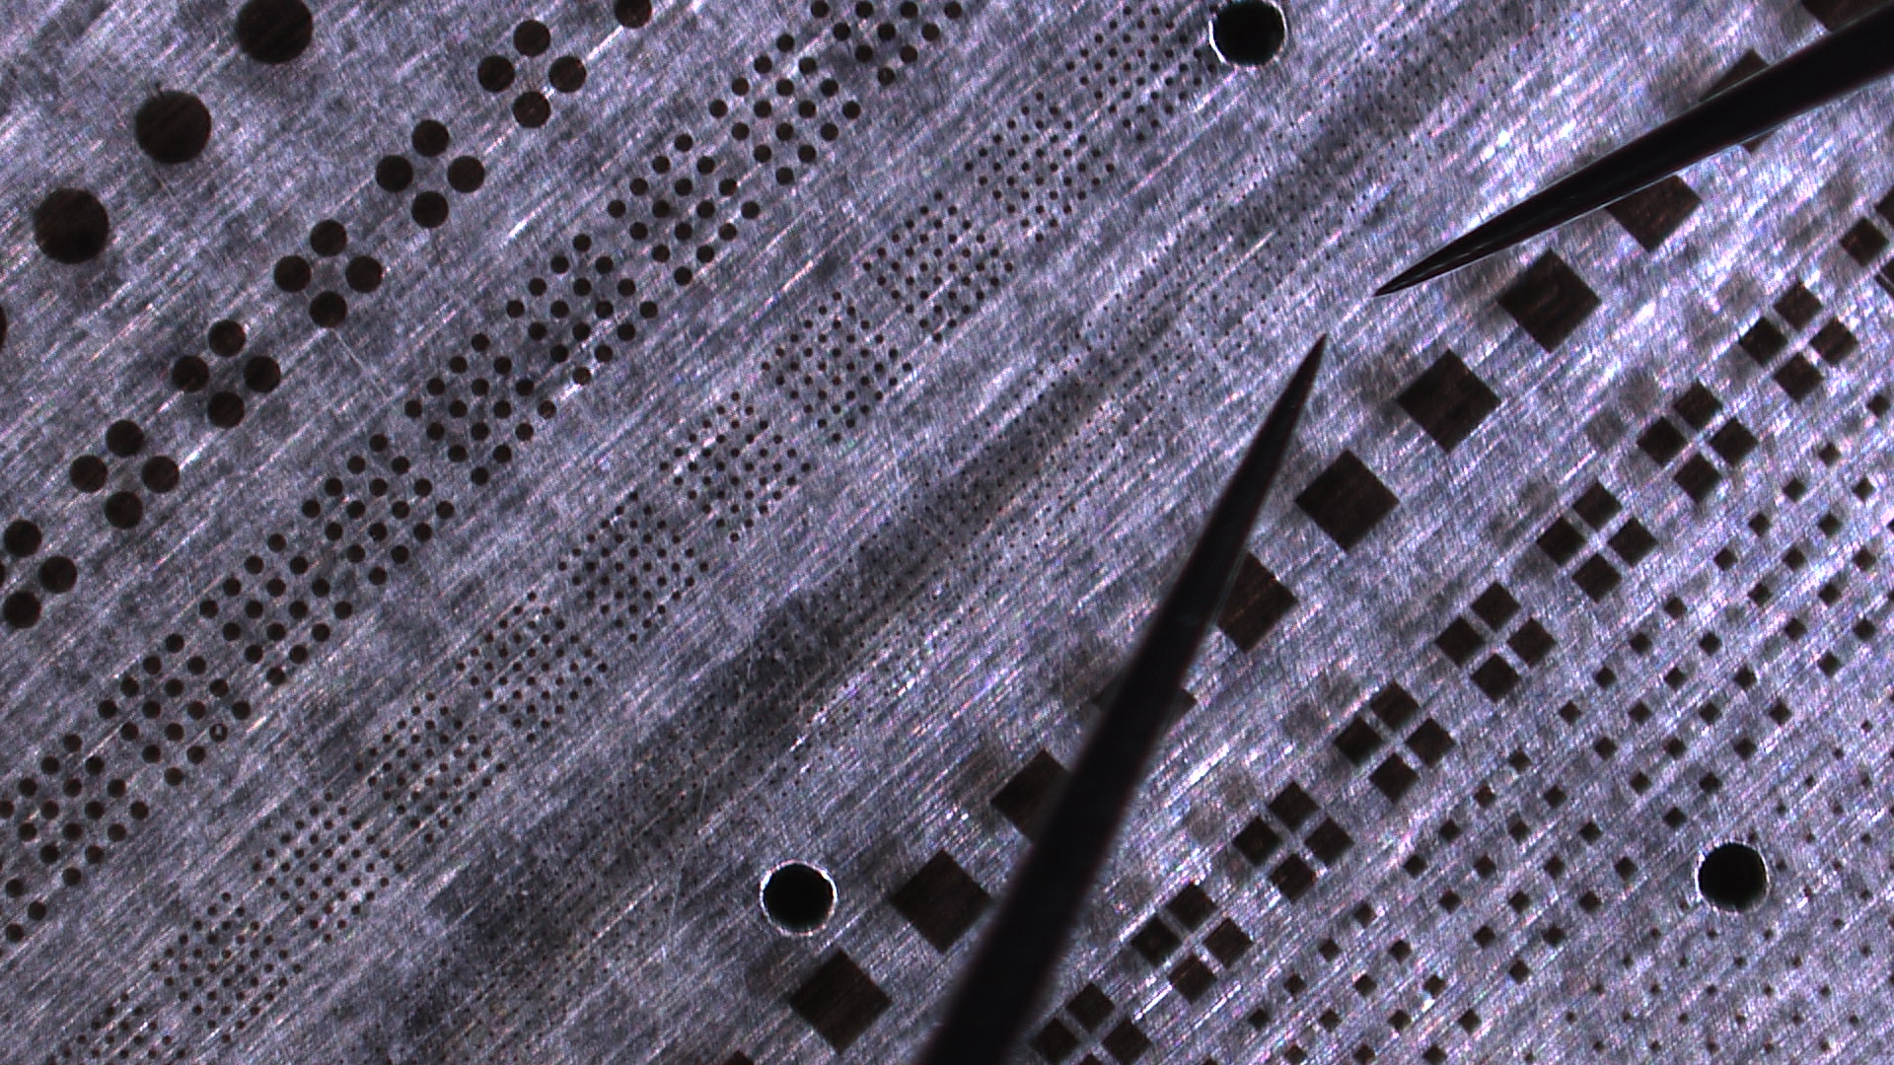

Experimental Method-Thin Film
Fabrication Procedure
Probing Side View
Probing Top-Down View
Data extracted with Semiconductor Device Analyzer [Keysight B1500A]
View from probe station camera.
***All films deposited by electron-beam physical vapor deposition at ${≈10}^{−6}$Torr

Slide 5
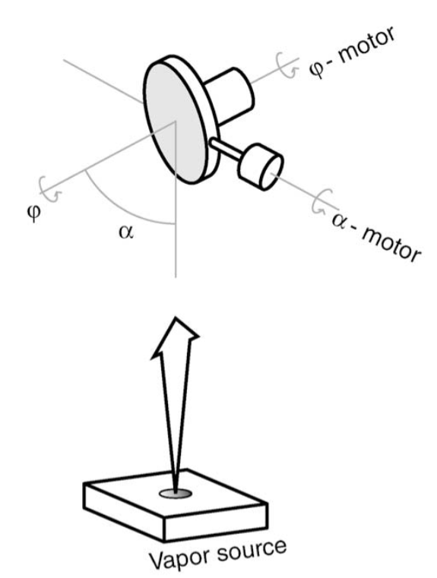
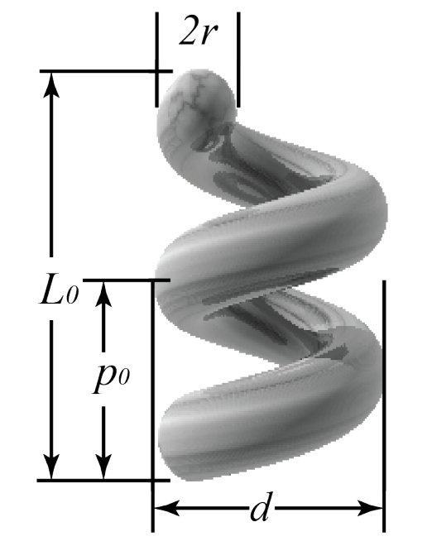
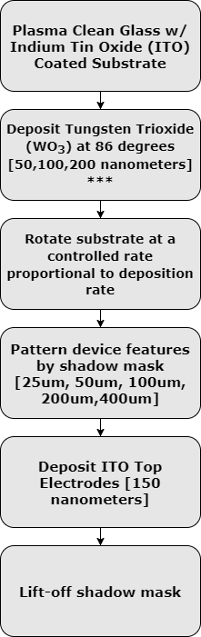
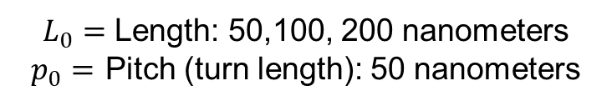
Experimental Method: Nano-Helix Films
Sumant Sarkar, Ryan O. Behunin, and John G. Gibbs Nano Letters 2019
Geometry of a Nano-Helix
Michael T. Taschuk et. al. Chapter 13 - Glancing Angle Deposition, Handbook of Deposition Technologies for Films and Coatings
$L_{0}=$ Length: 50,100, 200 nanometers
$p_{0}=$ Pitch (turn length): 50 nanometers
Glancing Angle Deposition Method

Slide 6
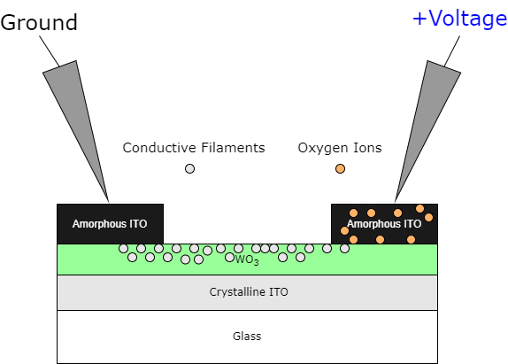
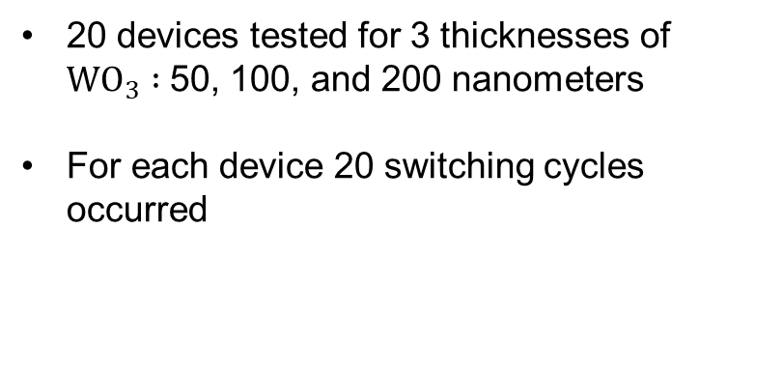
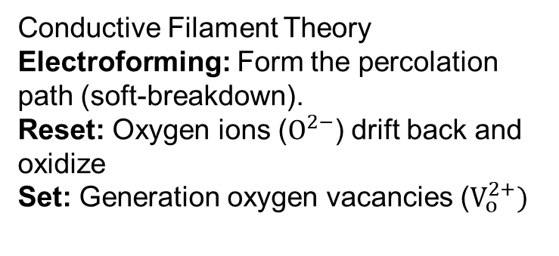
Results and Discussion
2
5
4
3
1
Conductive Filament Theory
Electroforming: Form the percolation path (soft-breakdown).
Reset: Oxygen ions ($O^{2−}$) drift back and oxidize
Set: Generation oxygen vacancies ($V_{o}^{2+})$
20 devices tested for 3 thicknesses of $WO_{3} :$50, 100, and 200 nanometers
For each device 20 switching cycles occurred
Ye, Cong et. al Applied Physics Express (2014)

Slide 7
Results and Discussion
Memory Window increases with decreasing thickness.
Operation voltage are below +/-1V (SET/RESET) for low power applications.
High endurance is demonstrated with 200 DC sweep cycles without significant memory drop.
Unpublished results, paper in progress

Slide 8
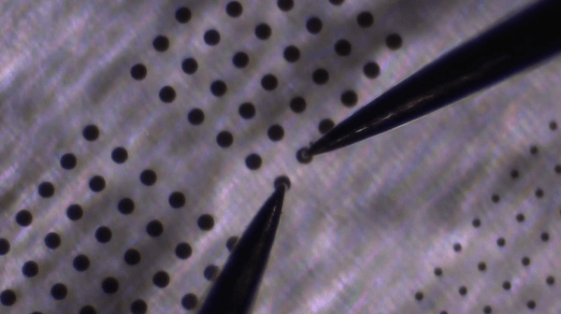
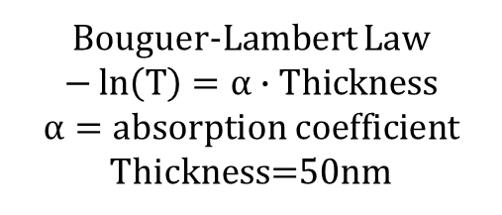
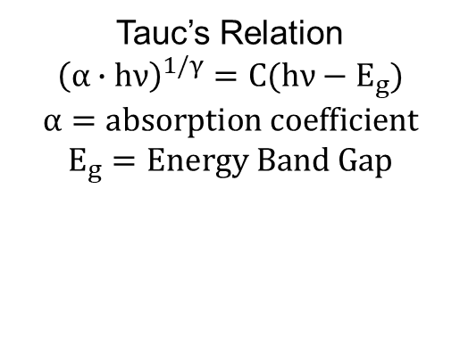
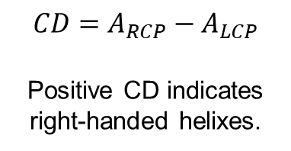
Optical Analysis and Observations
Bouguer-Lambert Law
$$−\ln\left(T\right)=α∙Thickness$$
$$α=absorption coefficient$$
Thickness=50nm
Tauc’s Relation
$${\left(α∙hν\right)}^{1/γ}=C(hν−E_{g})$$
$$α=absorption coefficient$$
$$E_{g}=Energy Band Gap$$
R. Sivakumar, et. al. Optical Materials, Volume 29, Issue 6, 2015
$${CD=A}_{RCP}−A_{LCP}$$
Positive CD indicates right-handed helixes.
Joule heating induced annealing
Sumant Sarkar, Ryan O. Behunin, and John G. Gibbs Nano Letters 2019

Slide 9
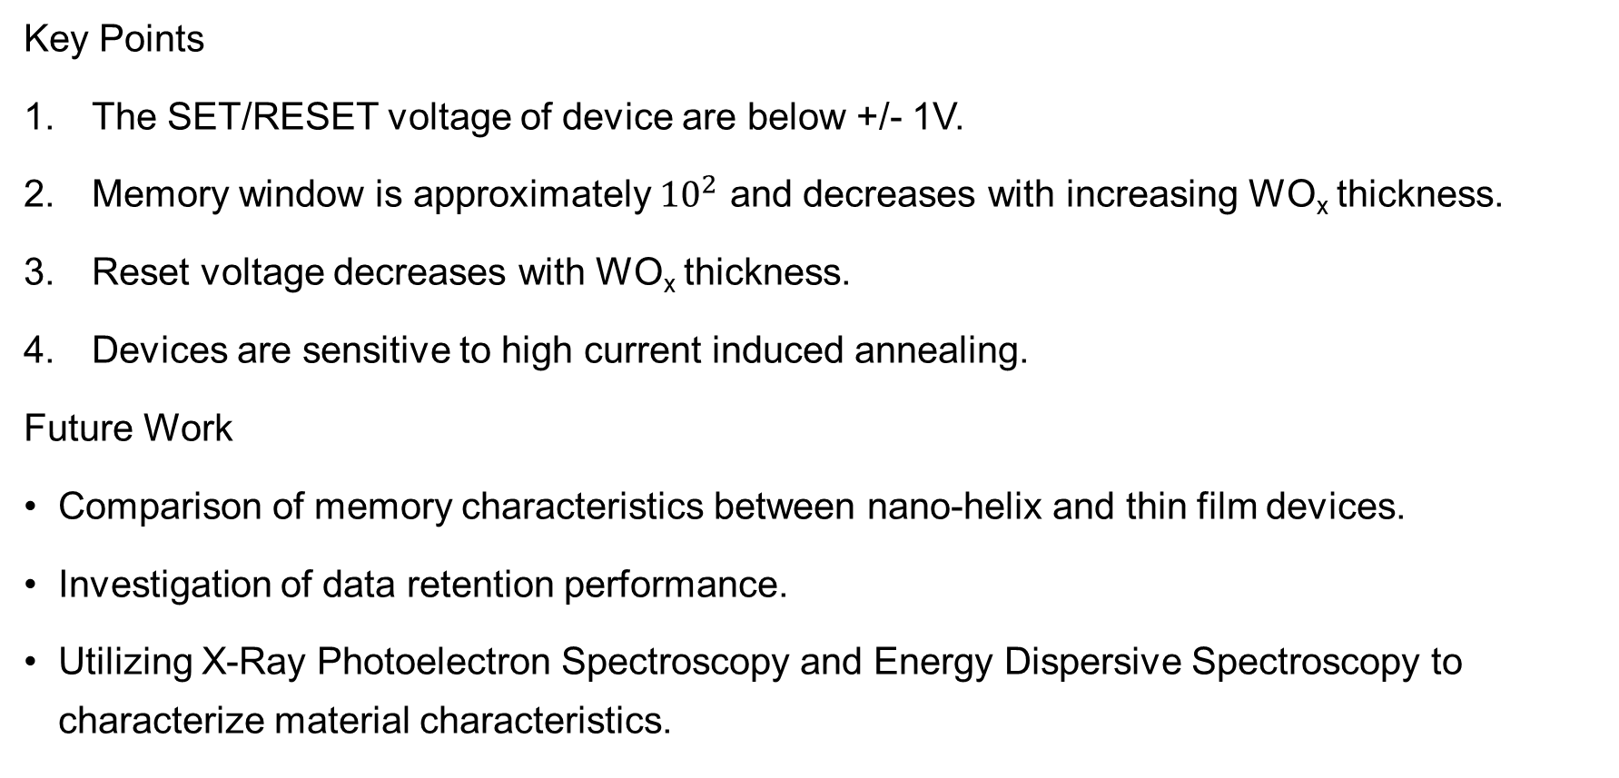
Conclusion and Future Work
Key Points
The SET/RESET voltage of device are below +/- 1V.
Memory window is approximately ${10}^{2}$ and decreases with increasing WO_{x} thickness.
Reset voltage decreases with WO_{x} thickness.
Devices are sensitive to high current induced annealing.
Future Work
Comparison of memory characteristics between nano-helix and thin film devices.
Investigation of data retention performance.
Utilizing X-Ray Photoelectron Spectroscopy and Energy Dispersive Spectroscopy to characterize material characteristics.

Slide 10
Acknowledgements
Dr. Ying-Chen Chen
Dr. John Gibbs
Dr. Sumant Sarkar
School of Informatics Computing and Cyber Systems
Semiconductor Device and Research Lab
Center for Materials Interfaces in Research and Applications

Slide 11
Thank you Questions?

